Slide 1
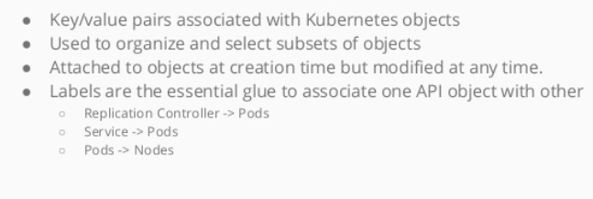
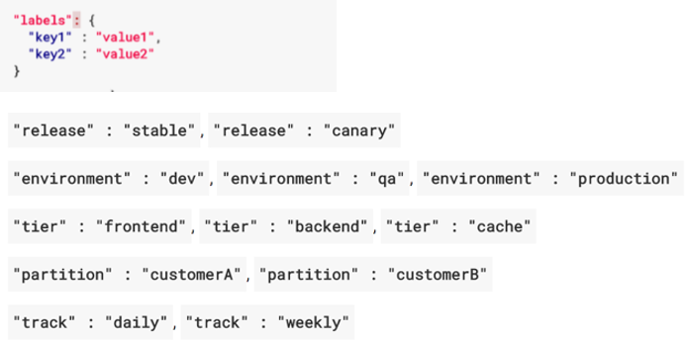
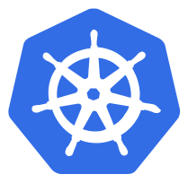
Labels

Slide 2
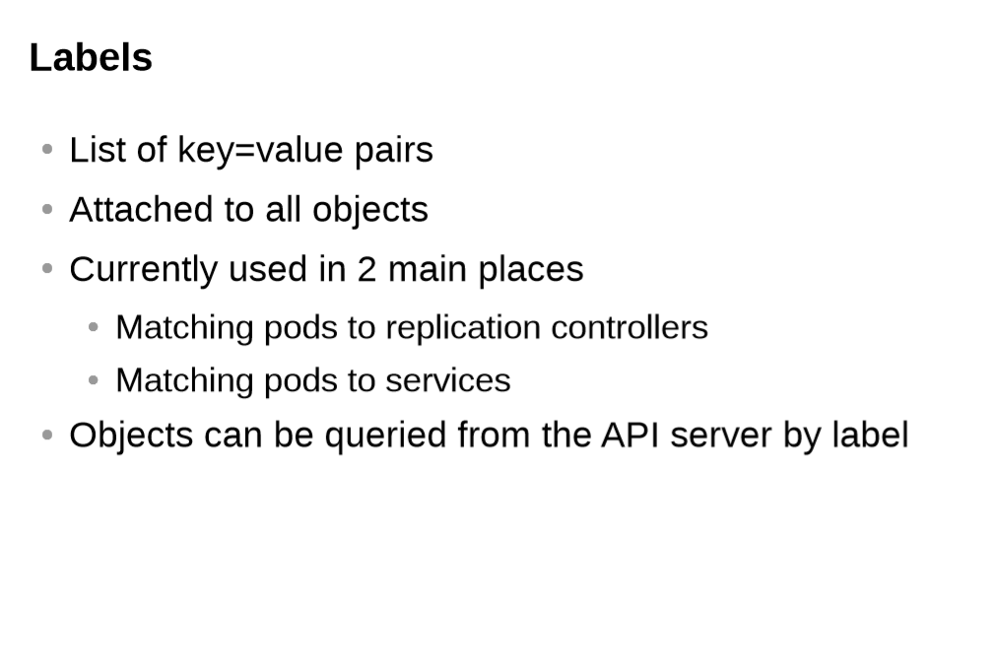

Slide 3
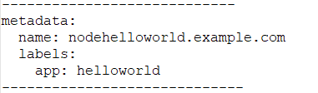
Labels
Labels are key/values pairs that can be attached to objects
Labels are like tags in AWS or other cloud providers, used to tag resources
You can label your objects, for instance your pod, following an org. structure
Key: environments - Value: Dev\ UAT\ QA\ PROD
Key: department - Value: R&D\ finance \ marketing
In our previous examples, I already have been using labels to tag pods

Slide 4
Labels
Labels are not unique & multiple labels can be added to one object
Once labels are attached to an object, you can use filters to narrow down results
This is called Label Selector
Using Label Selector, you can use matching expressions to match labels
For instance, a particular pod can only run on a node labeled with "environment" equal "Dev".
More complex matching: "environment" in "Dev" or "QA".

Slide 5
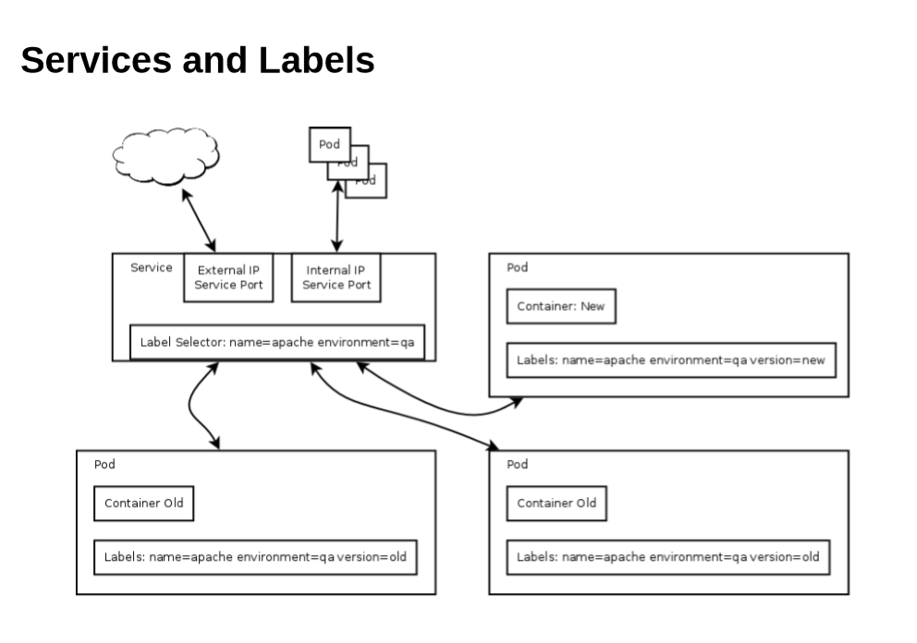

Slide 6
Node Labels
You can also use labels to tag nodes
Once nodes are tagged, you can use label selectors to let pods only run on specified nodes
There are 2 steps required to run a pod on specific set of nodes:
First you tag the node
Then you add a nodeSelector to your pod configuration

Slide 7


